Slide 1
Popularity of Words in Songs Through the Decades
Andrea Cicero
Devynn Moreno
Elsa Schieffelin
Avery Twitchell-Heyne

Slide 2
Hypothesis/Objectives
Compare song lyrical content over time
Comparison across decades of:
Word frequency
Word diversity
Notes:
+Compare song lyrical content over time to identify any recognizable trends in American popular music
Intro:
How do we analyze the words in lyrics
Hypothesis: Pop music has become fundamentally formulaic in terms of melody line. We wanted to see if this is also true for lyrical content. Like melodies are made from chords and notes, we examined the lyrics through words.
Is the language that we think of for these time periods reflected in the lyrics in the songs that we typically think about when we think about these time periods?

Slide 3
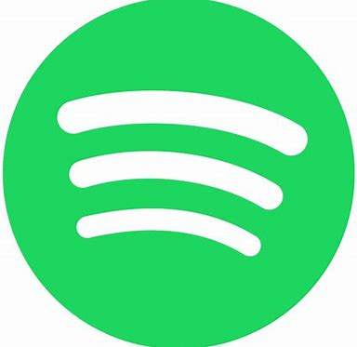
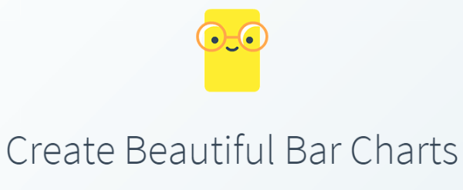


Methodology
Spotify Top #0s playlist
G
A
M
Words that are not ‘uh’
I
C
API
AP
I
Song metadata
Song lyrics
A P I
Notes:
Spotify API
Genius API
Tone Analyzer API
OEC API
How did we find the data? :
· How did we find Data? We used 2 APIs – Spotify API and Genius API. We chose these because they were readily available. Funnily enough, Billboards and Grammys do not have easily accessible APIs and though Spotify and Genius’ APIs were fair from easy, they were much better than their competitors (cough cough Apple Music).
· What did we pull? We pulled playlists from Spotify that were created by the Spotify team based on current user habits, grabbed the tracks from the playlist, grabbed the artists, songs, and song IDs, put that data into the Genius API through URL queries, scraped webpages of HTML, cleaned it up and split the lyrics on spaces to get us individual words. Then went through Oxford dictionary and taken out the top 50 words.
· Disclaimer: The playlists we pulled were made by the Spotify team or reflected top charts. Spotify playlists are curated by teams and they are based on Spotify user preferences. This means that our top songs from the 50s may not be the actual top songs in the 50s but they are what Spotify users currently deem are representative of that decade.

Slide 4
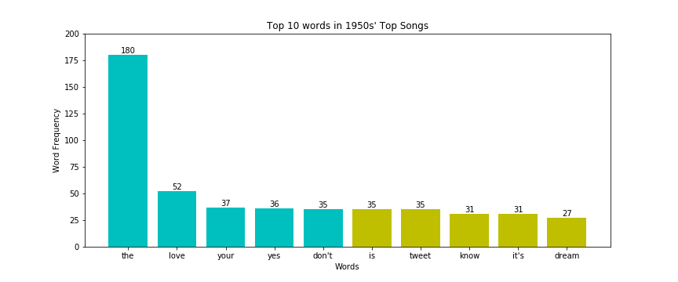
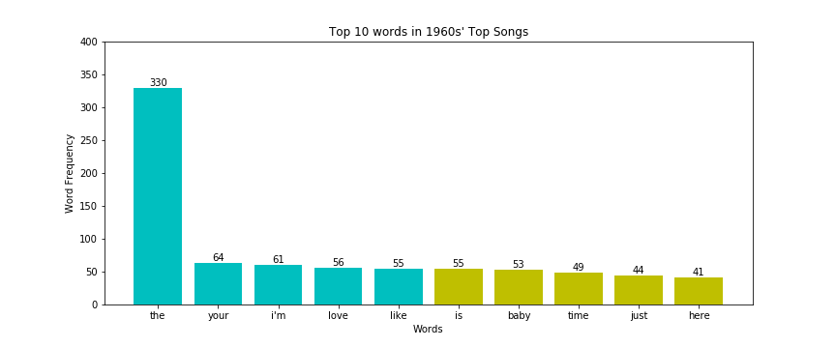
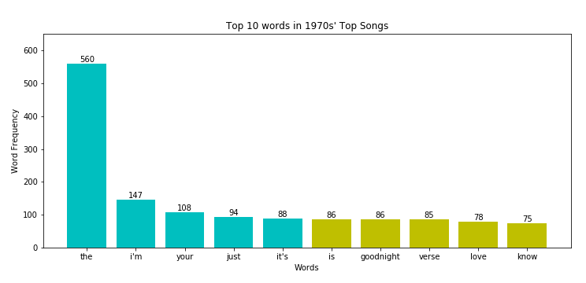
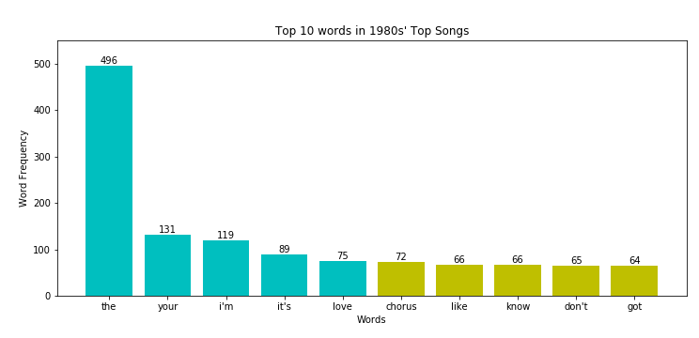
Data Analysis: 1950s - 1980s
The, love, your, yes, don’t,
is, tweet, know, it’s, dream
The, your, I’m, love, like, is
baby, time, just, here
The, I’m, your, just, it’s, is, goodnight, verse, love, know
The, your, I’m, it’s, love, chorus, like, know, don’t, get
Notes:
In general the words are the same across the decades with some notable outliers: goodnight, tweet
After the sixties the total number of words increases
Conclusions:
Hypothesis was false can’t determine real formula.
Rhetoric that we think of for these decades is also not reflected in our analysis
But we do see other trends:
Love is in every decade
I in most decades
Oh la and other sound words are popular in some decades
-Verse and Chorus in 70s and 80s

Slide 5
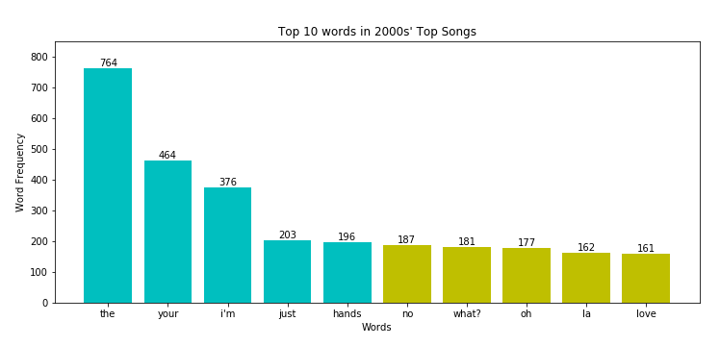
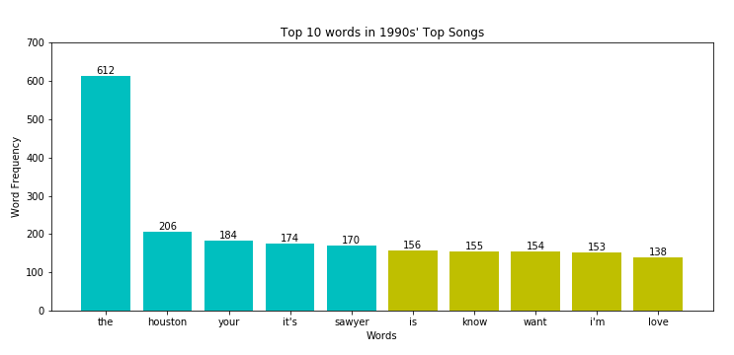
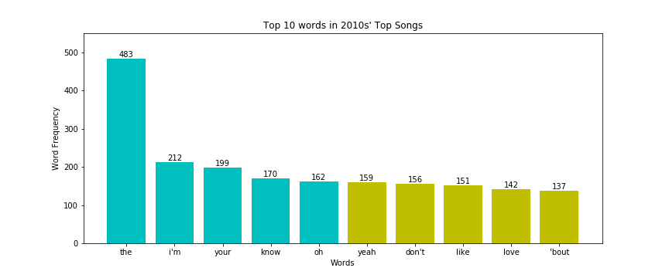
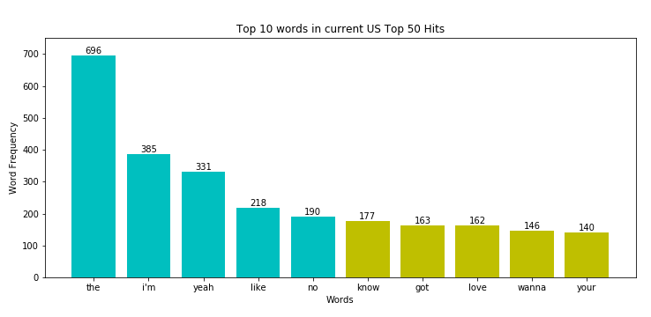
Data Analysis: 1990s - Today
The, houston, your, it’s, sawyer, is, know, want, I’m, love
The, your, I’m, just, hands, no, what, oh, la, love
The, I’m, your, know, oh, yeah, don’t, like, love, ‘bout
The, I’m, yeah, like, no, know, got, love, wanna, your
Notes:
In general the words are the same across the decades with some notable outliers: houston, sawyer; slang or not-real words (la, wanna, ‘bout)
Love, the, your appear in all decades
Should have taken out more common words (i.e., the)

Slide 6
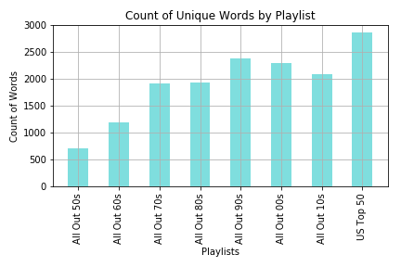
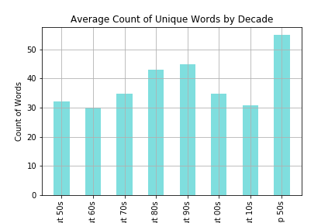
Word Diversity
Notes:
Count of unique words through playlists (word diversity)
-diversity increases over decade
-because of hip hop?
-accessibility of being a musician increases in the 80s

Slide 7
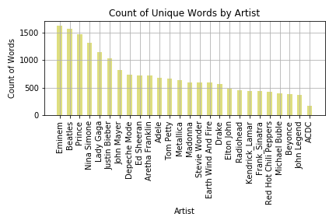
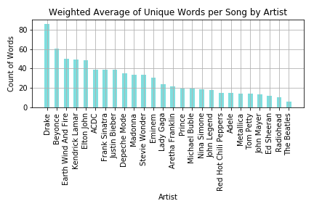
Word Diversity
Notes:
Sample Size of Artists --
-Extremes in charts
-1 unique words overall
-2 unique words per song
-song writers have a greater word diversity than those who do not?
-discography vs. subject matter?

Slide 8
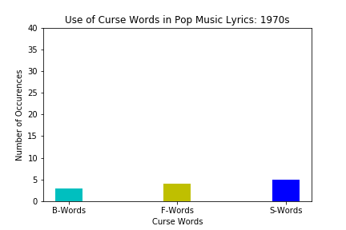
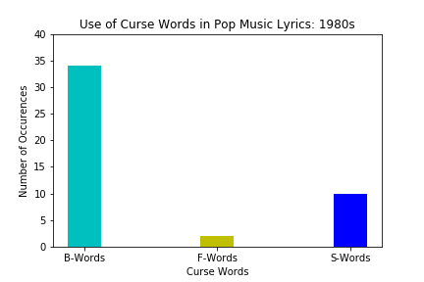
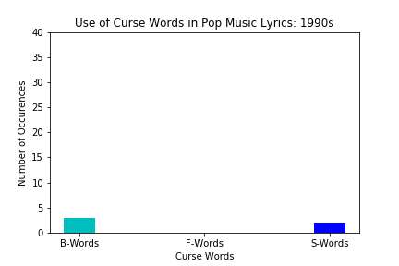
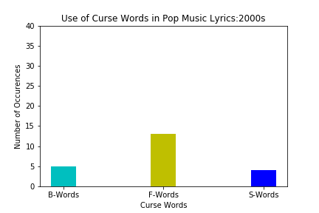
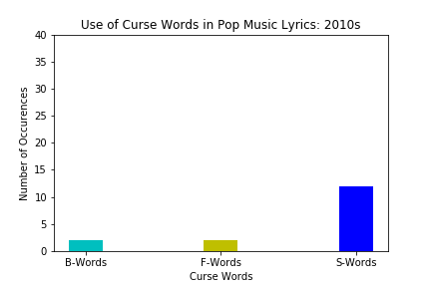
Curse Words
Notes:
Chi square of pooled curses from 1970s-2010s: 4.9 x 10-97 aka zero
Had to pool because of small frequencies for individual words
-we examined curse words
-starts in the 70s because there were none in the 50s and 60s
-70s we start to see things happening
-80s is the the camelot of swearing
-modern times we see the rise of the F bomb
-S words stay fairly constant

Slide 9
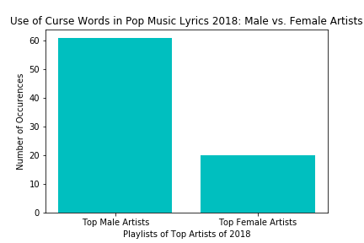
Notes:
Curses pooled
M: 138
F: 37
p=2.3x10-14 aka zero
-added up all swear words to see how they were used by contemporary male and female artists
-you can see here that male artists swear in their songs 3X as much as female artists

Slide 10
Conclusions and Implications
Notes:
Our language is full of articles and conjunctions and has not changed over the past few decades
structure isn’t changing but the words are
Word diversity increases
More word usage towards present

Slide 11
Questions?

Slide 12
Limitations/Assumptions
Trusting a third party to appropriately model popularity
Probable that Spotify has certain biases, including its user base
Spotify and Genius do not account for all songs produced
Qualify the study by presenting it as an analysis of Spotify as a rough proxy for describing American preference in music
The relationship between popularity and the technology available at the time
The playlists of the past were not created contemporarily as were current playlists
Data from US markets and select decades
100 song selection per decade
Utilizing Oxford English Corpus as standard for commonality in English words
Notes:
Verse and chor

